Slide 1

Real Estate Management Dashboard
GROUP 24
Presented by: Omar Ashurbayov, Lalith Kothuru, Pranav Kuchibhotla, Austin Samuel

Slide 2
Overview
Challenges
DEMO
Group Members
Agenda

Slide 3
Overview
Implemented RealEstate Database with mysql & python libraries
Worked on creating a schema for the Real Estate database setup
Implemented CRUD(Create, Read, Update, Delete) Operations
Collaborated with stakeholders using various technologies including VS code, PyCharm, SQL, GitHub, Google Docs, Zoom, and Discord to deliver a top-performing product.

Slide 4
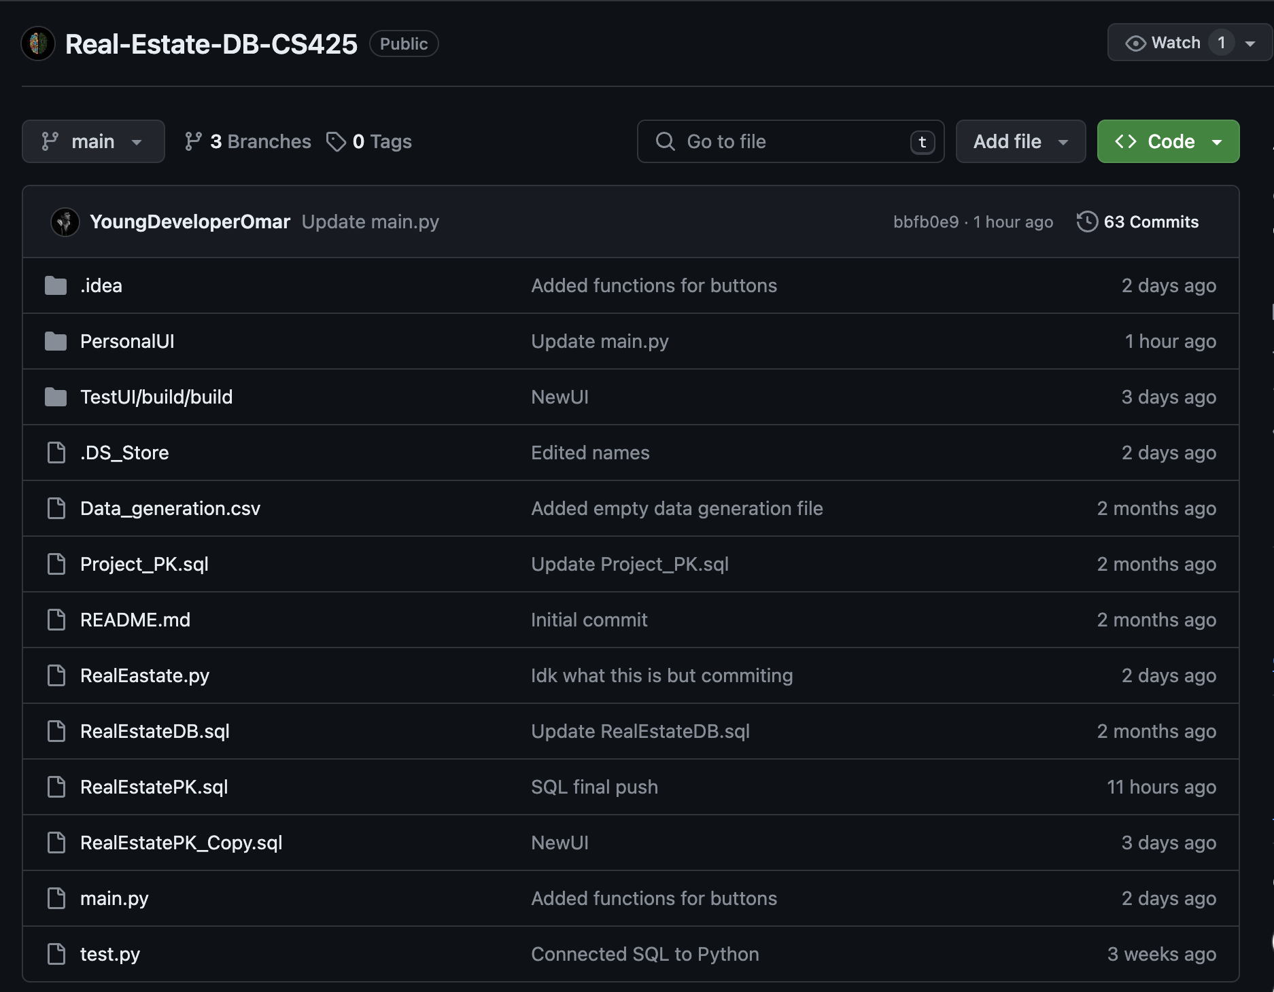
Challenges Overcome
Designing UI
Using new python libraries
Time management
Connecting SQL and Python
Team work
Using various applications

Slide 5
DEMO

Slide 6

Questions?

Slide 7





